Slide 1

Influence of Parsimony and Work-related Psychological Constructs in Predicting Turnover Intention when Using Machine Learning VS Regression
Diego Figueiras

Slide 2
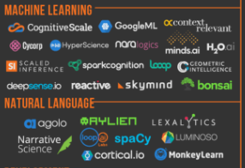
Introduction
Notes:
Give an intro to ML here. Discussion what these programs are to get caught to speed

Slide 3
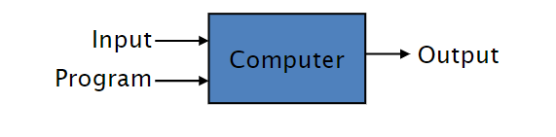
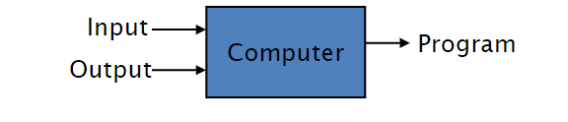
What is machine learning?
Theory-based approach
Empirical-based approach

Slide 4
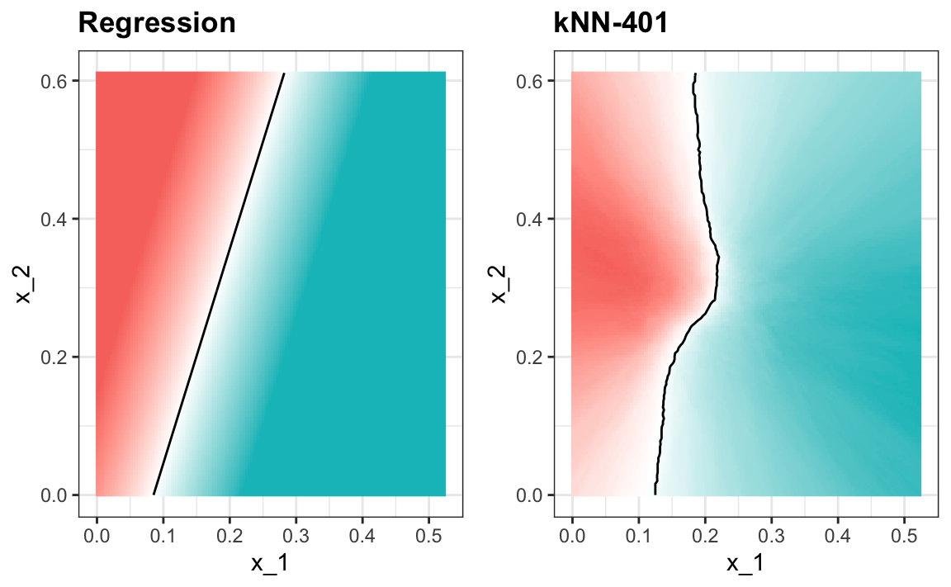
Benefits of Machine Learning

Slide 5
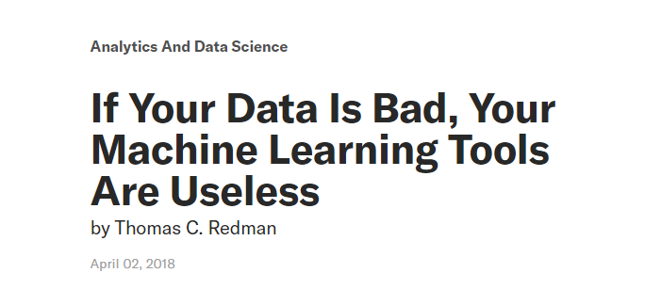

GIGO problem (garbage in, garbage out)

Slide 6
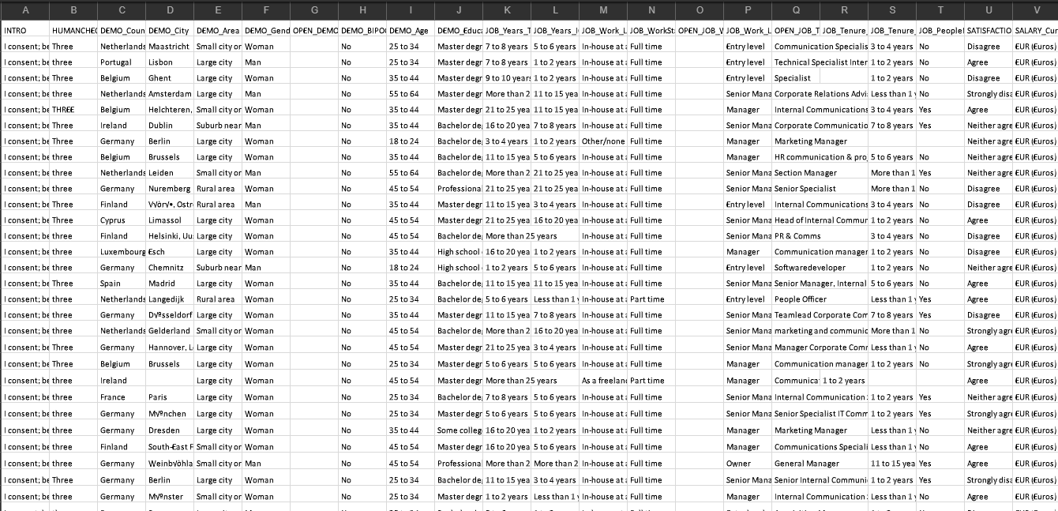
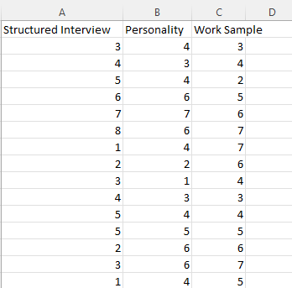
Parsimony and sparsity
Why use this...
when you can just use this?

Slide 7
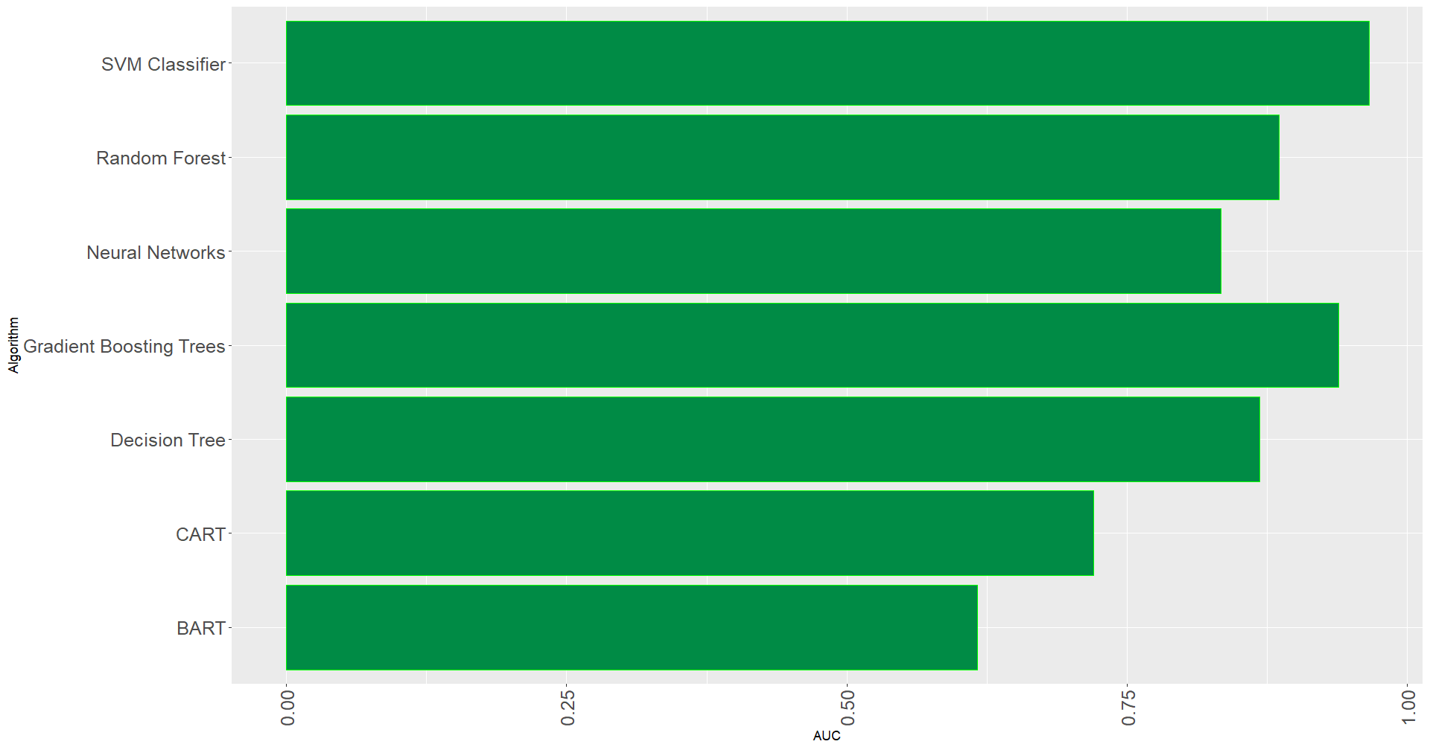
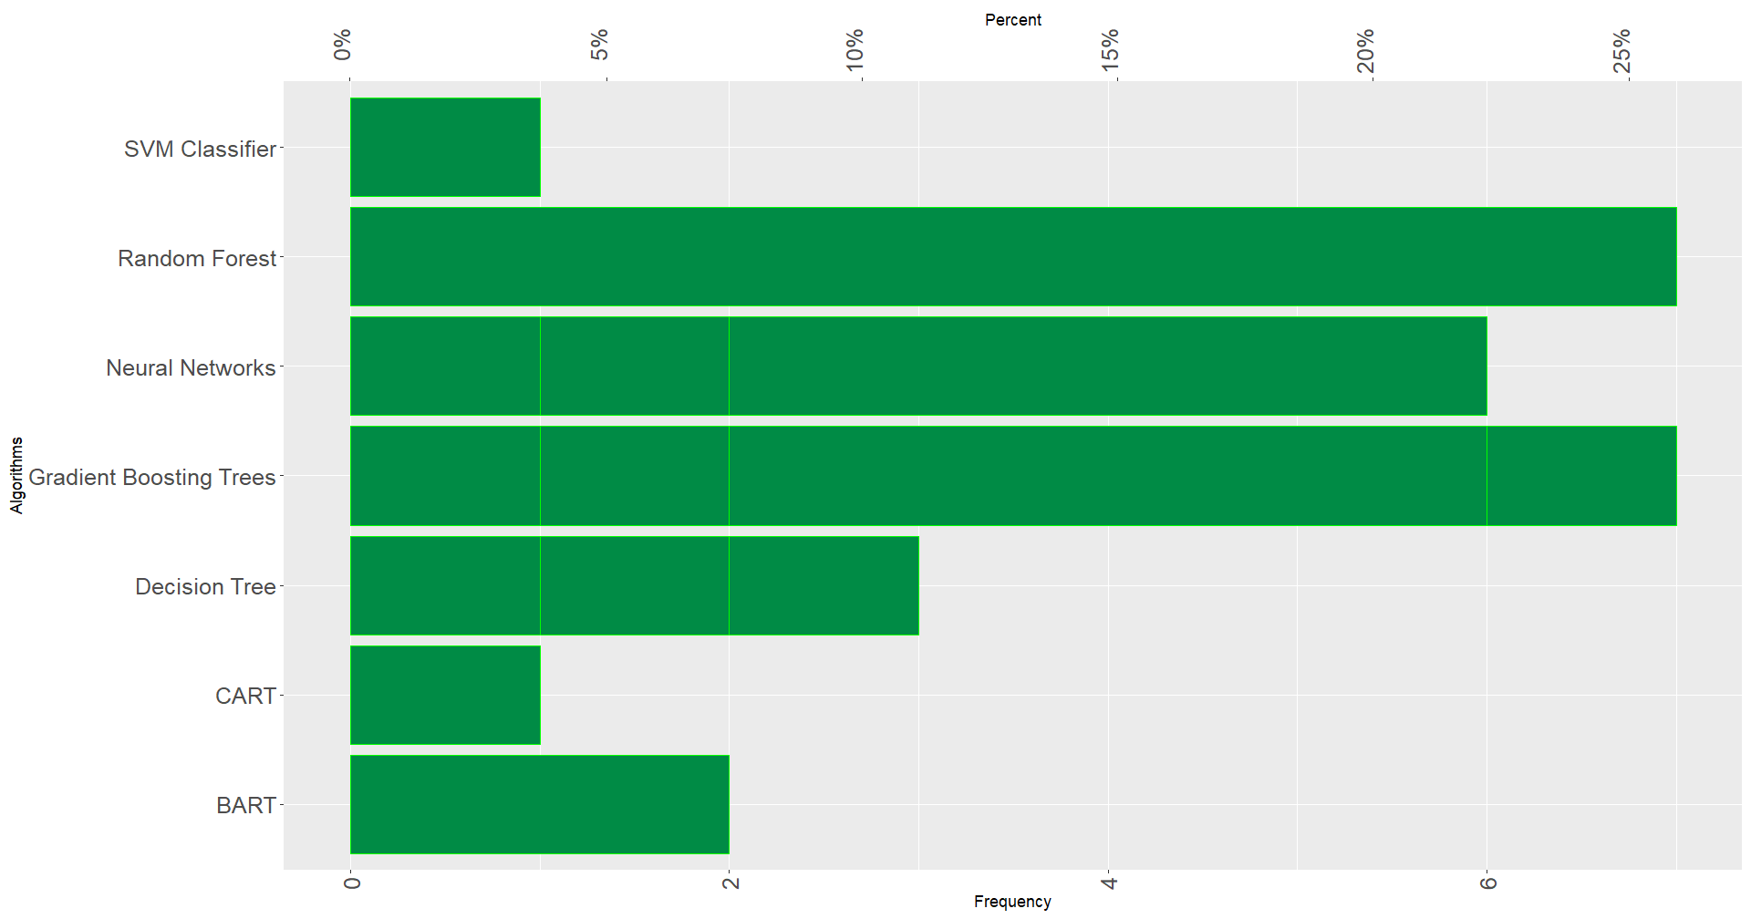
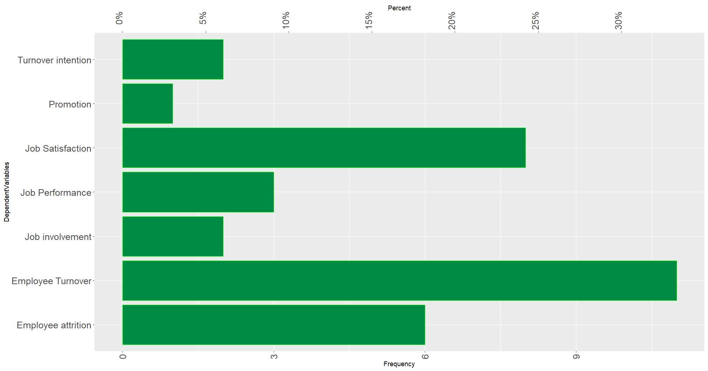
Key Findings from Prelims
GBT and SVM highest accuracies
Random Forest and GBT most common algorithms
Turnover most common DV
Notes:
Discuss here about some of the ML algorithms too

Slide 8
Conclusions
GBT producing the highest accuracy
Only two articles out of the twenty-seven reviewed had data with sample sizes above 260,000
Median events (people) per variable (EPV) was 44
Using machine learning algorithms with such small number of variables could compromise the bias-variance tradeoff, overfitting the data.

Slide 9

Hypotheses
H1
As sample size increases, the relative advantage of ML algorithms over regression-based algorithms in predictive accuracy of turnover intention will increase.
H2:
As the number of variables increases, the relative advantage of ML algorithms over regression-based algorithms in predictive accuracy of turnover intention will increase.
H3a:
machine learning models trained with work-related psychological constructs will show better predictive accuracy metrics when predicting turnover intention than models trained using biodata.
H3b:
the predictive accuracy of machine learning models will increase when work-related psychological constructs are added to the model.
Study 1
Study 2

Slide 10

Study 1
Federal Employee Viewpoint Survey (FEVS)
Developed by the Office of Personnel Management (OPM)
105 variables
N=557,779

Slide 11
Study 1
Independent variables
My Work Experience: Employee’s personal work experiences and opinions
My Work Unit: Employee’s opinions regarding cooperation, recruitment, quality, and performance management in the work unit.
My Organization: employee’s opinions covered agency policies and practices related to job performance, performance appraisals, workplace diversity and fairness, as well as perceptions of employees’ personal empowerment, safety, and preparedness.
My Supervisor: employees’ perceptions of their supervisor
Leadership: the effectiveness of the agency’s senior leaders and managers, overall, and in motivating employees, maintaining high ethical standards, communicating organizational policies, and generating respect.
My Satisfaction: addressed employee satisfaction with various aspects of their jobs, including pay, job training, opportunities for advancement, recognition for work well done, and the policies and practices of senior leaders.

Slide 12
Study 1
Independent Variables (cont.)
Diversity, Equity, Inclusion, and Accessibility: employees perceptions of policies and practices related to diversity, equity, and inclusion in their agency and also meeting accessibility needs.
Employee Experience: employees’ experience of they experience their work and what motivates them.
Pandemic, Transition to the Worksite, Workplace Flexibilities: addressed the continuing impact of the COVID-19 pandemic and decisions related to returning to the worksite.
Paid Parental Leave: the experiences of using the new paid parental leave benefit for employees who indicated they had used it.

Slide 13
Study 1
Dependent Variable
Turnover Intention: employee’s intention to leave their organization.
“Are you contemplating leaving your organization within the next year, and if so, why?”
A) No.
B) Yes, to take another job within the Federal Government.
C) Yes, to take another job outside the Federal Government.
D) Yes, other.

Slide 14
Data analysis
Logistic Regression
4 ML Algorithms:
Xgboosting
Neural Network
Support Vector Machines
Random Forest
10 k-fold
4/5 Training set
1/5 Testing set

Slide 15
Data Analysis
N | K
100,000 | 105
10,000 | 105
1,000 | 105
100 | 105
100,000 | 75
10,000 | 75
1,000 | 75
100 | 75
100,000 | 15
10,000 | 15
1,000 | 15
100 | 15

Slide 16
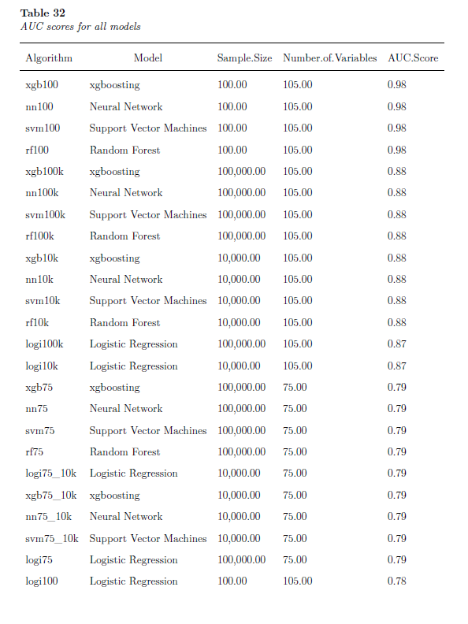
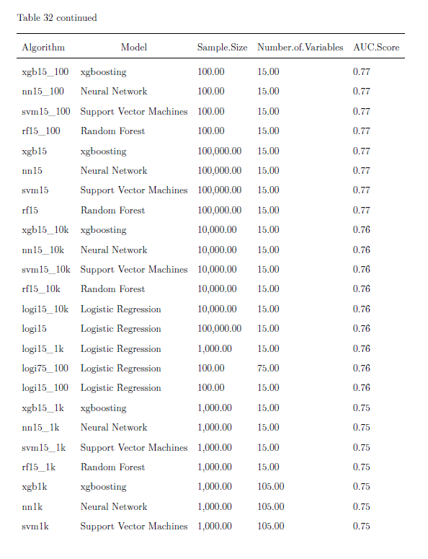
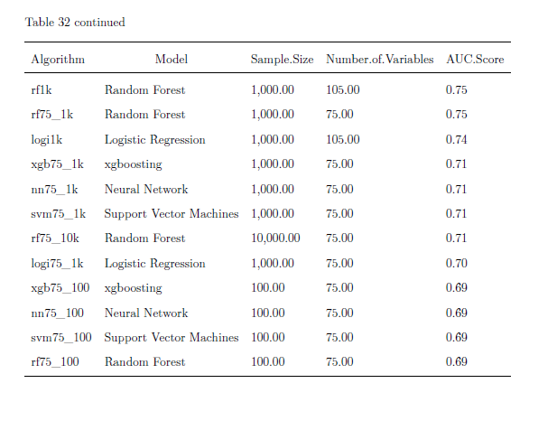
Study 1
Results

Slide 17
Study 1
Results
Interactive Table Time!!!!

Slide 18
Study 1
Conclusions:
Hypothesis 1 partially supported: ML algorithms slightly outperform regression regardless of sample size.
Hypothesis 2 partially supported: ML algorithms slightly outperform regression regardless of number of variables.

Slide 19
Study 1
Criticism
ML might be overfitting the data
Black box
Difference doesn’t matter: regression useful for theory crafting
ML only focuses on prediction

Slide 20
Study 2
Utility for academic researchers
Can we answer theoretical questions with these models?
Qualtrics survey
Amazon Mturk
281 – 241 after exclusion due to attention checks and incompletion
$1.50 per assignment
$500 total

Slide 21
Study 2
Independent Variables (Work-related psychological constructs)
3-items Utrecht Work Engagement Scale (UWES-3)
9-items Lodahl and Kejner’s Job Involvement Scale (JI)
Affective (ACS) and normative (NCS) components of the revised Three-Component Model (TCM) Employee Commitment Survey
1-item Graphic Scale of Organizational Identification (GSOI)
8-item Survey of Perceived Organizational Support (SPOS)
Conscientiousness - 6-items Big Five Inventory – Short Form (BFI-2-S)

Slide 22
Study 2
Independent Variable (Biodata):
Educational and job-related experiences
Training and skills
Historical performance indicators
Job engagement metrics
Involvement in organized activities
Recognition for achievements
General satisfaction with pay, benefits, and job location

Slide 23
Study 2
Dependent Variables
Turnover Intention
Job Satisfaction - Michigan Organizational Assessment Questionnaire (MOAQ) short form

Slide 24
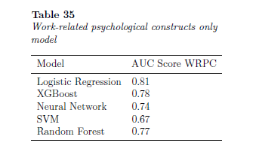
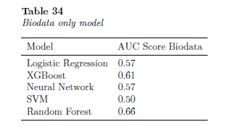
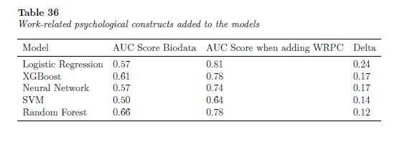
Study 2
Results – Predicting Turnover Intention

Slide 25
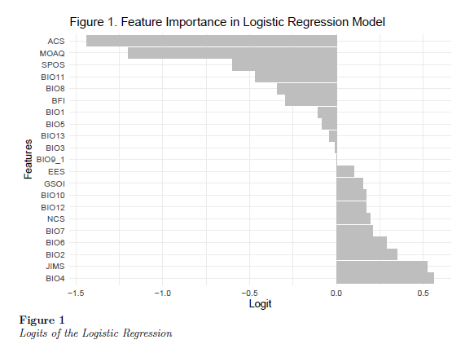
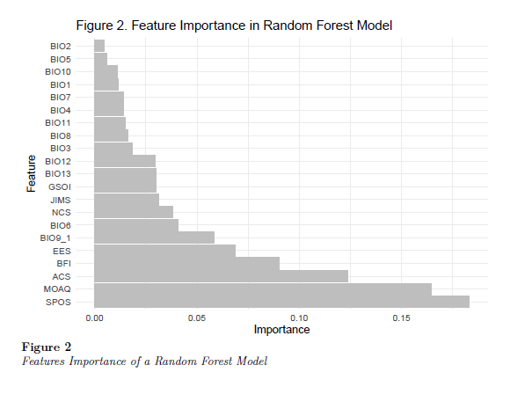
Study 2
Results – Predicting Turnover Intention
Capitalize on covariance

Slide 26
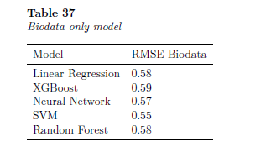
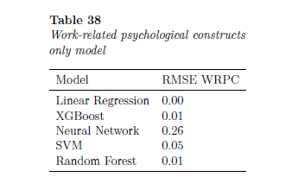
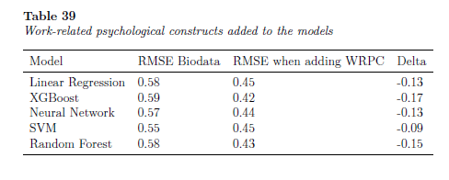
Study 2
Results – Predicting Job Satisfaction

Slide 27
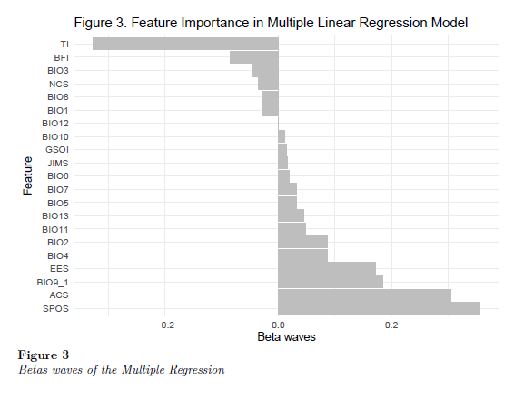
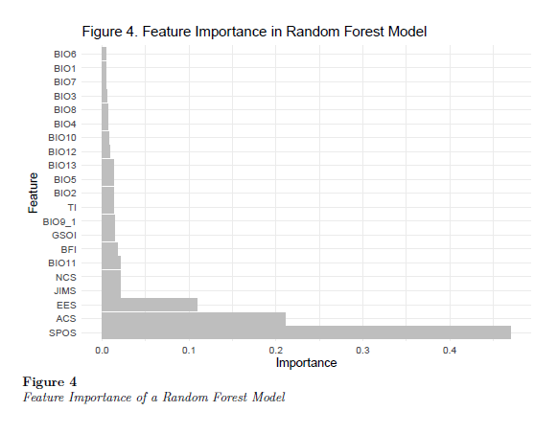
Study 2
Results – Predicting Job Satisfaction

Slide 28
Study 2
Conclusions:
Similar incremental validity metrics
Overlapping feature relevance between ML and regression
ML could be a better alternative for theory building

Slide 29
Discussion
ML at least as good as regression for small sample sizes and few number of variables
ML could be explored as an alternative methodology for theory building (specially when sample size is small)

Slide 30
Limitations
Federal employees only in study 1
No feature engineering
No rigorous fine tunning done on ML models
ML has additionally complexity for tunning the models
Not optimizing the models
TI a limited DV
Random Forest can show direction of predictor relevance
Study 2 uses online survey data

Slide 31
Future Directions
Results comparable
Convergence in methods
ML helpful in the early stages of a path analysis

Slide 32

Q&A

